Slide 1



Healthy Kids
Healthy Communities
Civic Engagement Training
December 11, 2024

Slide 2
House of Representatives Map
(HKHC)

Slide 3
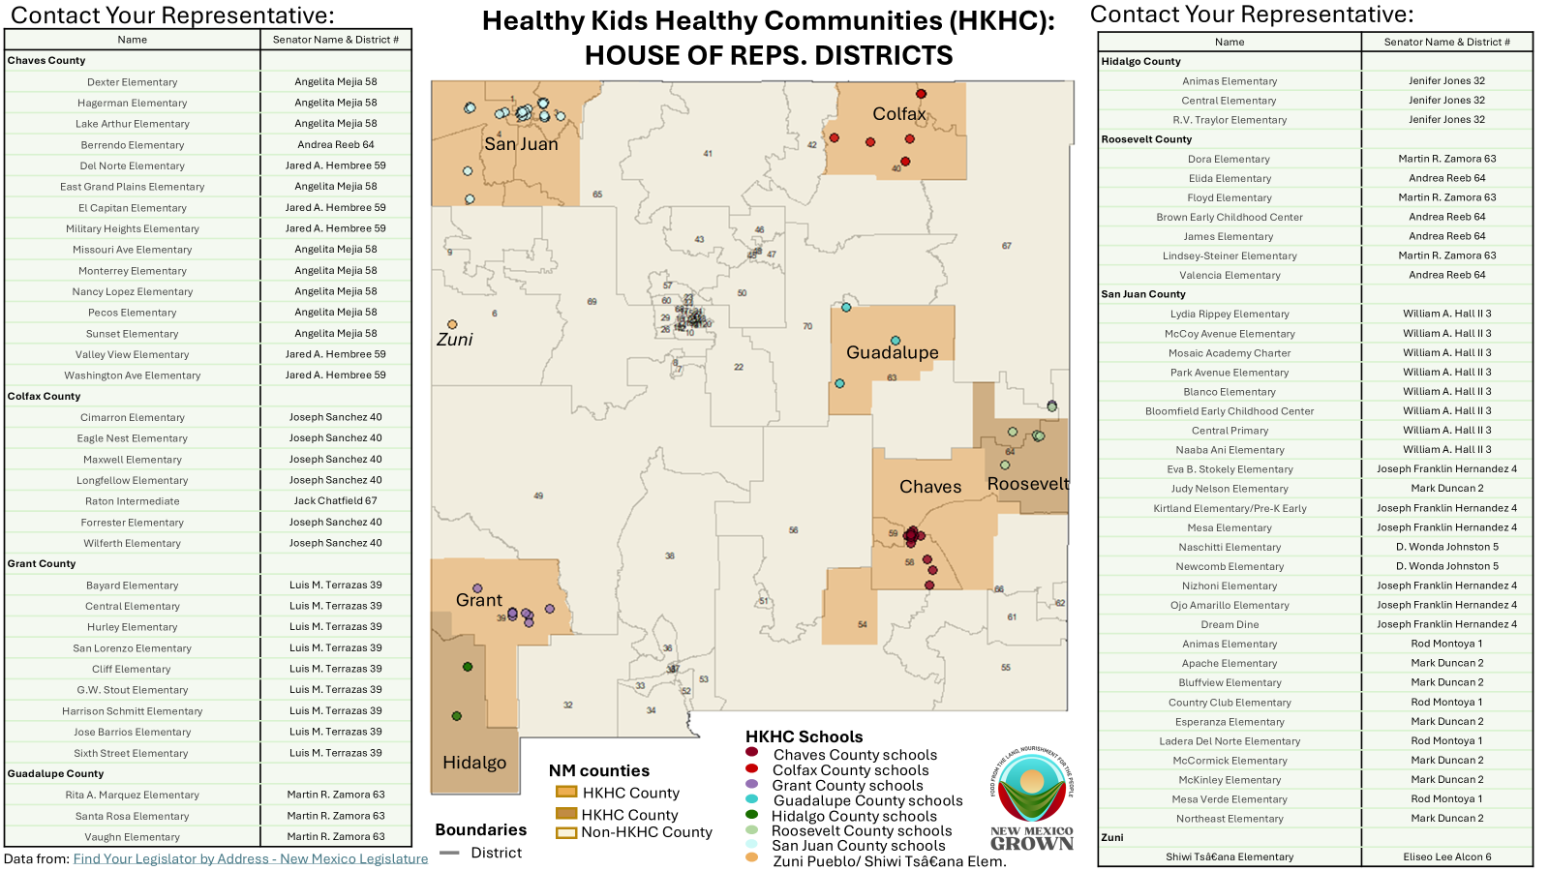

Slide 4
Senate Map
(HKHC)

Slide 5
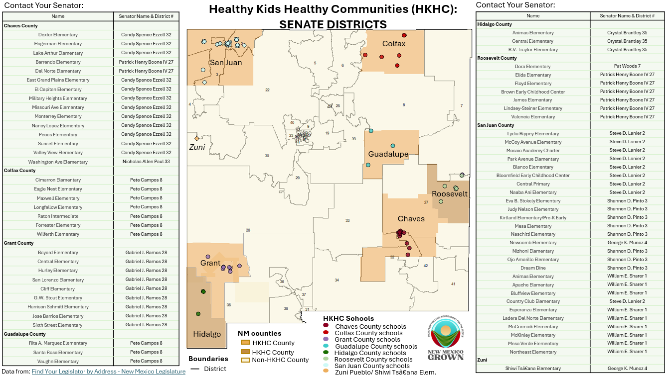

Slide 6
Chaves County

Slide 7
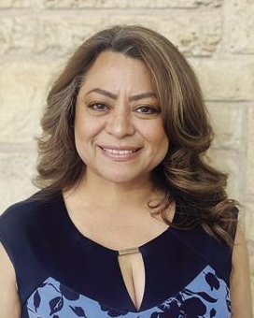
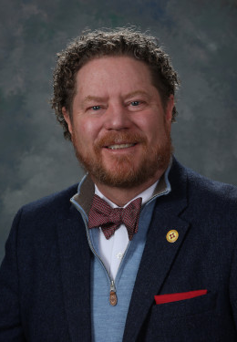

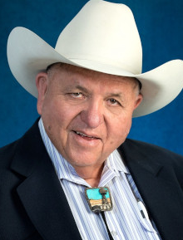
Photo | Name | House or Senate | Party | County | District | Mailing Address & Office | Email Address | Phone Number
 | Angelita Mejia* | House | Republican | Chaves | 58
 | Jared Hembree | House | Republican | Chaves | 59 | P.O. Box 3358 Roswell, NM 88202 Office 203EN | jared.hembree @nmlegis.gov | (505) 986-4211 Aide: Casey Conlee casey.conlee @nmlegis.gov
 | Jonathan Allen Henry* | House | Republican | Chaves, Eddy & Otero | 54
 | Jimmy G. Mason | House | Republican | Chaves, Eddy & Lea | 66 | 205 W. Main St., Artesia, NM 88210 Office 203B | jimmy.mason @nmlegis.gov | (505) 986-4226 Aide: Estefani Hammond estefani.hammond @nmlegis.gov

Slide 8

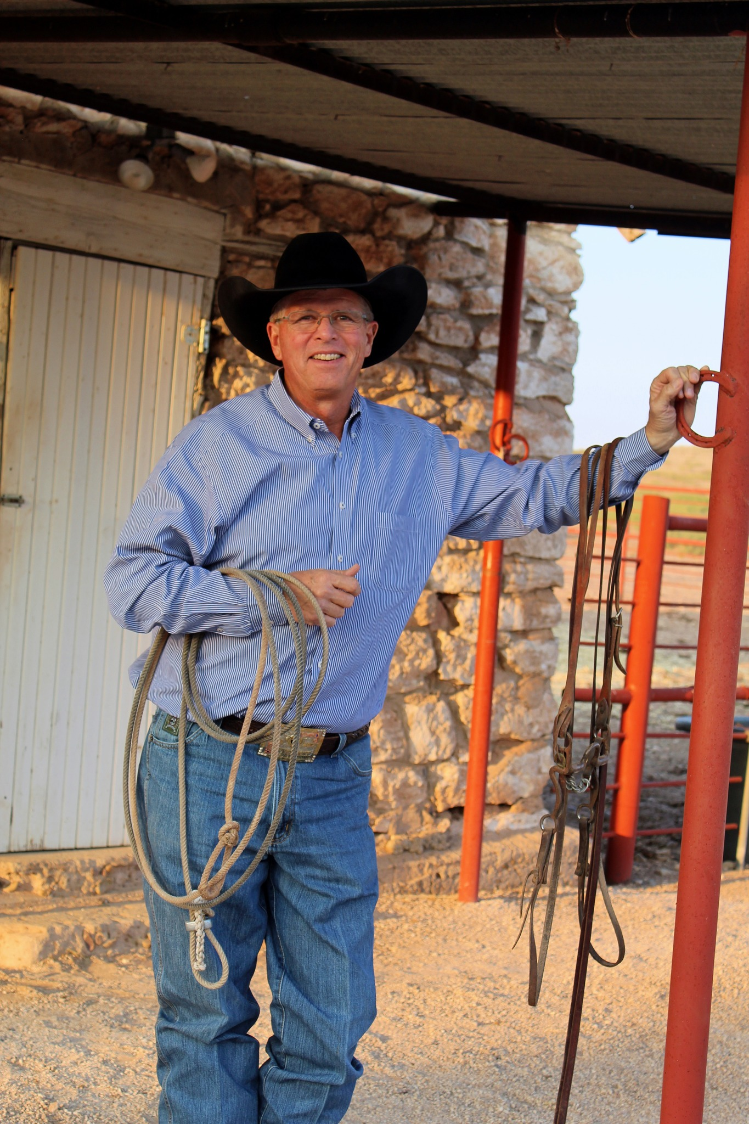
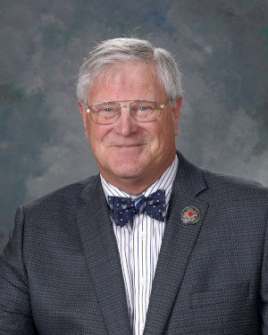
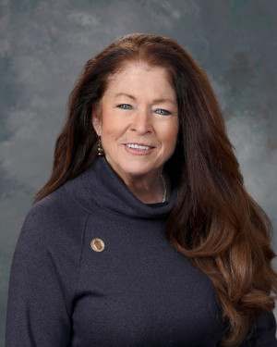
Photo | Name | House or Senate | Party | County | District | Mailing Address & Office | Email Address | Phone Number
 | Nicholas Allan Paul* | Senate | Republican | Chaves, Lincoln & Otero | 33
 | Patrick Henry Boone IV* | Senate | Republican | Chaves, Curry, De Baca, Lea & Roosevelt | 27
 | Larry R. Scott | Senate | Republican | Chaves, Eddy & Lea | 42 | P.O. Box 1708, Hobbs NM 88241 Office 203GN | larry.scott @nmlegis.gov | (505) 986-4450
 | Candy Spence Ezzell | Senate | Republican | Chaves, Eddy & Otero | 32 | P.O. Box 2125, Roswell NM 88202 | csecows @aol.com | (505) 986-4454

Slide 9
Colfax County

Slide 10
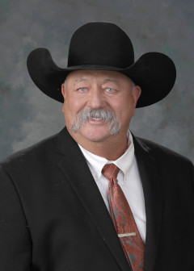
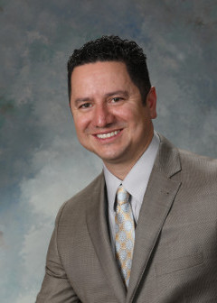
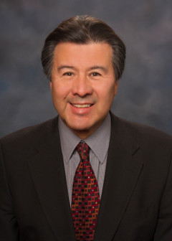
Photo | Name | House or Senate | Party | County | District | Mailing Address & Office | Email Address | Phone Number
 | Jack Chatfield | House | Republican | Colfax, Curry, Harding, Quay, San Miguel, & Union | 67 | P.O. Box 226 Mosquero, NM 87733 Office 203FN | jack.chatfield @nmlegis.gov | (505) 986-4467
 | Joseph L. Sanchez | House | Democrat | Colfax, Mora, Rio Arriba, San Miguel & Taos | 40 | P.O. Box 481 Alcalde, NM 87511 Office 204A | joseph.sanchez @nmlegis.gov | (505) 986-4233
 | Pete Campos | Senate | Democrat | Colfax, Guadalupe, Harding, Mora, Quay, San Miguel & Taos | 8 | 418 Raynolds Avenue Las Vegas, NM 87701 Office 302B | pete.campos @nmlegis.gov | (505) 986-4311 Aide: Jesse Gallegos jesse.gallegos @nmlegis.gov

Slide 11
Grant County

Slide 12
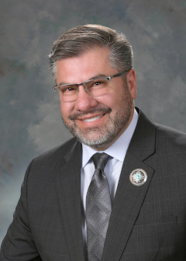
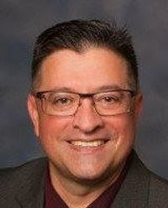
Photo | Name | House or Senate | Party | County | District | Mailing Address | Email Address | Phone Number
 | Luis M. Terrazas | House | Republican | Grant, Catron & Hidalgo | 39 | P.O Box 197 Santa Clara, NM 88026 Office 203DN | luis.terrazas @nmlegis.gov | (505) 986-4336 Aide: Bruce Ashburn bruce.ashburn @nmlegis.gov
 | Gabriel J. Ramos* | Senate | Republican | Grant, Catron & Socorro | 28

Slide 13
Guadalupe County

Slide 14
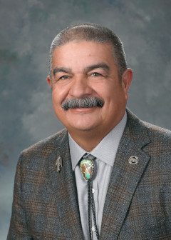
Photo | Name | House or Senate | Party | County | District | Mailing Address | Email Address | Phone Number
 | Martin R. Zamora | House | Republican | Guadalupe, Curry, DeBaca, Roosevelt & San Miguel | 63 | 116 Rosa Boulevard, Clovis NM 88101 Office 203EN | martin.zamora @nmlegis.gov | (505) 986-4211 (575) 309-2334
 | Pete Campos | Senate | Democrat | Guadalupe, Colfax, Harding, Mora, Quay, San Miguel & Taos | 8 | 418 Raynolds Avenue Las Vegas, NM 87701 Office 302B | pete.campos @nmlegis.gov | (505) 986-4311

Slide 15
Hidalgo County

Slide 16


Photo | Name | House or Senate | Party | County | District | Mailing Address & Office | Email Address | Phone Number
 | Jennifer Jones | House | Republican | Hidalgo, Doña Ana & Luna | 32 | P.O. Box 1844 Deming, NM 88030 Office 203A | jenifer.jones @nmlegis.gov | (505) 986-4227
 | Crystal Diamond Brantley | Senate | Republican | Hidalgo, Doña Ana, Luna & Sierra | 35 | P.O Box 1947 Elephant Butte, NM 87935 Office 414C | crystal.diamond@nmlegis.gov | (505) 986-4703 Aide: Joaquin Romero joaquin.romero @nmlegis.gov

Slide 17
Roosevelt County

Slide 18
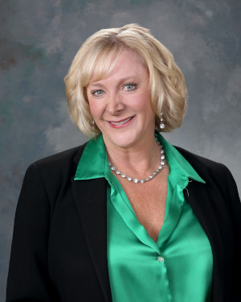
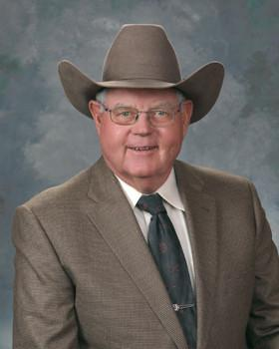
Photo | Name | House or Senate | Party | County | District | Mailing Address | Email Address | Phone Number
 | Martin R. Zamora | House | Republican | Roosevelt, Curry, DeBaca, Guadalupe & San Miguel | 63 | 116 Rosa Boulevard, Clovis, NM 88101 Office 203EN | martin.zamora @nmlegis.gov | (505) 986-4211 (575) 309-2334
 | Andrea Reeb | House | Republican | Roosevelt, Chaves & Curry | 64 | 15 San Vincente Cir., Clovis, NM 88101 Office 201A | andrea.reeb @nmlegis.gov | (505) 986-4215
 | Patrick Henry Boone IV* | Senate | Republican | Roosevelt, Chaves, Curry, De Baca & Lea | 27
 | Pat Woods | Senate | Republican | Curry, Quay & Union (+Dora) | 7 | 4000 CR M, Broadview, NM 88112 Office 415D | pat.woods @nmlegis.gov | (505) 986-4393 Aide: Mason Grau mason.grau @nmlegis.gov

Slide 19
San Juan County

Slide 20

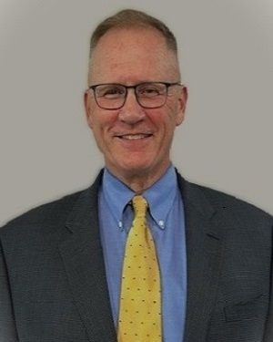

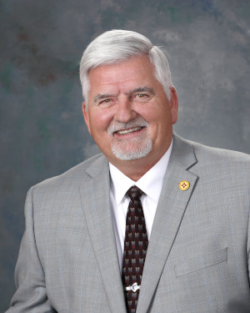
Photo | Name | House or Senate | Party | County | District | Mailing Address | Email Address | Phone Number
 | Michelle “Paulene” Abeyta* | House | Democrat | San Juan, Bernalillo, Cibola, McKinley, Socorro & Valencia | 69
 | William A Hall II | House | Republican | San Juan | 3 |  | bill.hall @nmlegis.gov | (505) 402-6368 Aide: April Gonzalez april.gonzalez @nmlegis.gov
 | Joseph Franklin Hernandez* | House | Democrat | San Juan | 4
 | Mark Duncan | House | Republican | San Juan | 2 | P.O. Box 747 Kirtland, NM 87417 Office 201B | mark.duncan @nmlegis.gov | (505) 986-4214

Slide 21
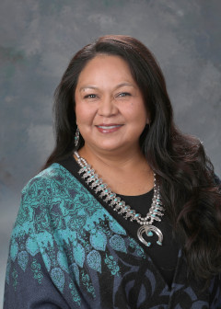
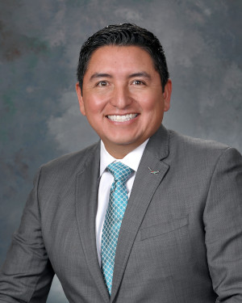
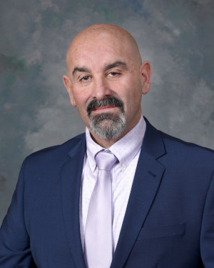
Photo | Name | House or Senate | Party | County | District | Mailing Address | Email Address | Phone Number
 | D. Wonda Johnson | House | Democrat | San Juan & McKinley | 5 | P.O. Box 168 Rehoboth, NM 87322-0168 Office 413D | dwonda.johnson @nmlegis.gov | (505) 986-4433
 | Derrick J. Lente | House | Democrat | San Juan, Rio Arriba & Sandoval | 65 | 70 Kuaua Street Sandia Pueblo, NM 87004 Office 316B | derrick.lente @nmlegis.gov | (505) 986-4420
 | Rod Montoya | House | Republican | San Juan | 1 | 4902 Camaron Ave. Farmington, NM 87402 Office 203DN | roddmontoya @gmail.com | (505) 986-4336 Aide: Rylee Morris rylee.morris @nmlegis.gov

Slide 22
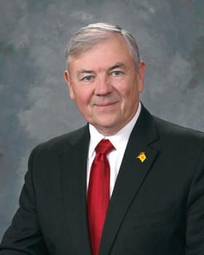
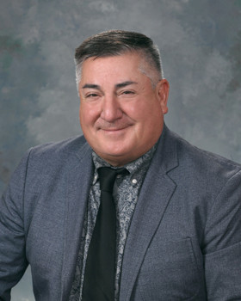
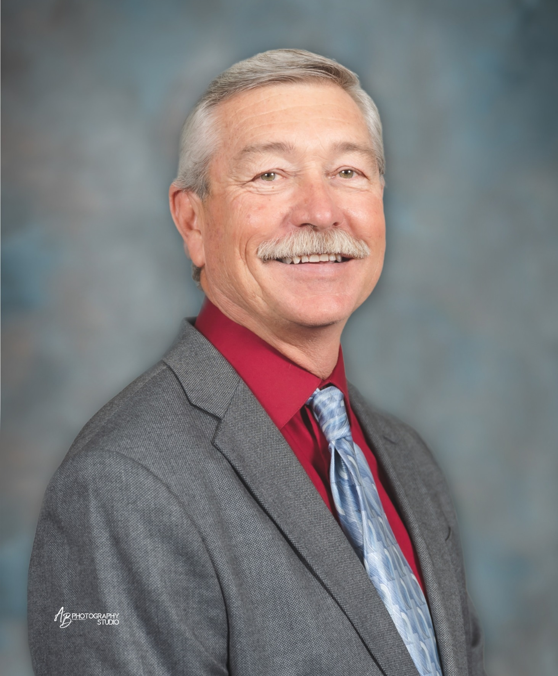
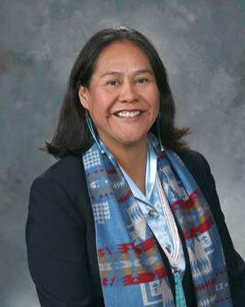
Photo | Name | House or Senate | Party | County | District | Mailing Address | Email Address | Phone Number
 | William E. Sharer | Senate | Republican | San Juan | 1 | P.O. Box 203 Farmington, NM 87499 Office 415H | bill @williamsharer.com | (505) 986-4381 Aide: Tracee Loughran tracee.loughran@nmlegis.gov
 | George K. Muñoz | Senate | Democrat | San Juan, Cibola & McKinley | 4 | P.O. Box 2679 Gallup, NM 87305 Office 325B | george.munoz @nmlegis.gov | (505) 986-4371
 | Steve D. Lanier* | Senate | Republican | San Juan | 2
 | Shannon D. Pinto | Senate | Democrat | San Juan & McKinley | 3 | P.O. Box 549 Tohatchi, NM 87325 Office 301B | shannon.pinto @nmlegis.gov | (505) 986-4835

Slide 23
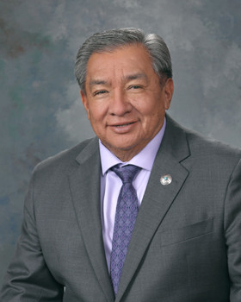
Photo | Name | House or Senate | Party | County | District | Mailing Address | Email Address | Phone Number
 | Benny Shendo Jr. | Senate | Democrat | San Juan, Bernalillo, McKinley, Rio Arriba & Sandoval | 22 | PO Box 634 Jemez Pueblo, NM 87024 Office 323A | benny.shendo @nmlegis.gov | (505) 986-4310

Slide 24
Santa Fe County

Slide 25

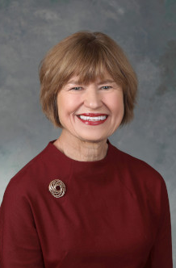
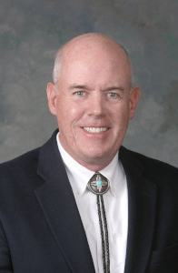
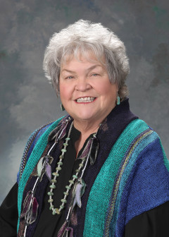
Photo | Name | House or Senate | Party | County | District | Mailing Address | Email Address | Phone Number
 | Reena Szczepanski | House | Democrat | Santa Fe | 47 | 1000 Cordova Place #973 Santa Fe, NM 87505 Office 134B | reena .szczepanski @nmlegis.gov | (505) 986-4777 Aide: Ashley Watson ashley.watson@nmlegis.gov
 | Christine Chandler | House | Democrat | Santa Fe, Los Alamos & Sandoval | 43 | P.O. Box 1565, Los Alamos, NM 87544 Office 308A | christine .chandler @nmlegis.gov | (505) 986-4411 Aide: Laurel Minter laurel.minter @nmlegis.gov
 | Matthew McQueen | House | Democrat | Santa Fe & Sandoval | 50 | 7 Caliente Road A-11 Box 818 Santa Fe, NM 87508-3105 Office 316A | matthew .mcqueen @nmlegis.gov | (505) 986-4423 Aide: Sarah Boses sarah.boses @nmlegis.gov
 | Susan K. Herrera | House | Democrat | Santa Fe, Rio Arriba, Sandoval & Taos | 41 | P.O. Box 189 Embudo, NM 87531 Office 327 | susan.herrera @nmlegis.gov | (505) 986-4333

Slide 26
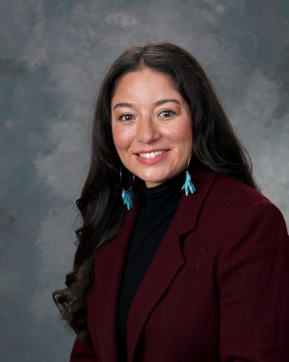
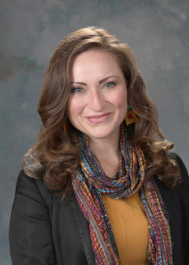
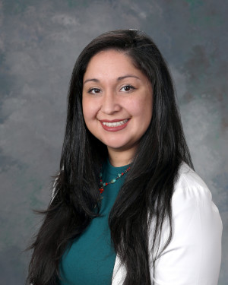
Photo | Name | House or Senate | Party | County | District | Mailing Address | Email Address | Phone Number
 | Andrea Romero | House | Democrat | Santa Fe | 46 | P.O. Box 32963 Santa Fe, NM 87594 Office 205A | andrea @andrearomero .com | (505) 986-4243 (505) 490-6155
 | Tara L. Lujan | House | Democrat | Santa Fe | 48 | 1430 Galisteo Street, Santa Fe NM 87505 Office 413F | tara.lujan @nmlegis.gov | (505) 986-4432 Aide: Alexandra Wylie alexandra.wylie @nmlegis.gov
 | Linda Serrato | House | Democrat | Santa Fe | 45 | P.O. Box 28043, Santa Fe NM 87592 Office 205A | linda.serrato @nmlegis.gov | (505) 986-4243

Slide 27
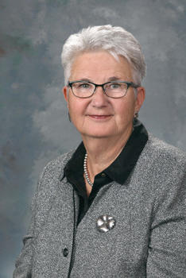
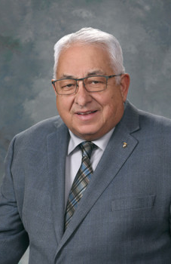
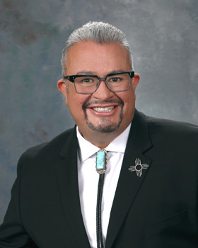

Photo | Name | House or Senate | Party | County | District | Mailing Address | Email Address | Phone Number
 | Elizabeth "Liz" Stefanics | Senate | Democrat | Santa Fe, Bernalillo, Lincoln, San Miguel, Torrance & Valencia | 39 | P.O. Box 720 Cerrillos, NM 87010 Office 328B | lstefanics @msn.com | (505) 986-4377 Aide: Anne Strader deborahanne .strader @nmlegis.gov
 | Roberto "Bobby" J. Gonzales | Senate | Democrat | Santa Fe, Los Alamos, Rio Arriba & Taos | 6 | 26 Lavender Lane Ranchos De Taos, NM 87557 Office 217 | roberto.gonzales @nmlegis.gov | (505) 986-4362
 | Leo Jaramillo | Senate | Democrat | Santa Fe, Los Alamos, Rio Arriba & Sandoval | 5 | P.O. Box 1014 Espanola, NM 87532 Office 300 | leo.jaramillo @nmlegis.gov | (505) 986-4487 Aide: Briana Salazar briana.salazar @nmlegis.gov
 | Linda Trujillo* | Senate | Democrat | Santa Fe | 24

Slide 28
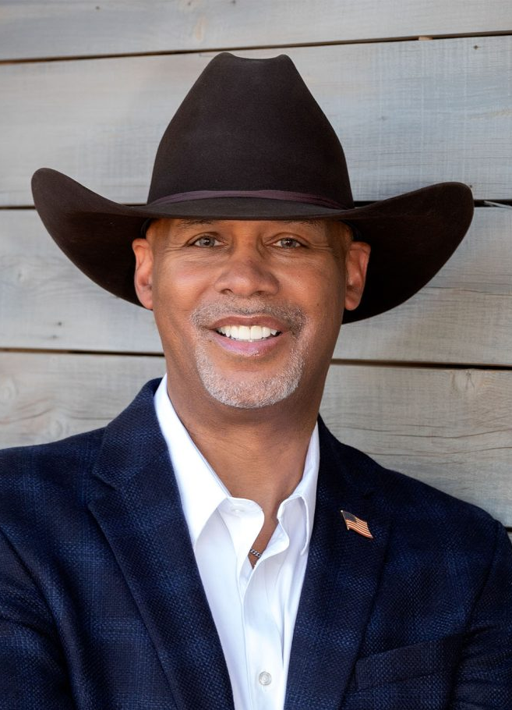
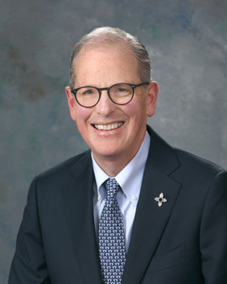
Photo | Name | House or Senate | Party | County | District | Mailing Address | Email Address | Phone Number
 | Ant Thornton* | Senate | Republican | Santa Fe, Bernalillo, Sandoval & Torrance | 19
 | Peter Wirth | Senate | Democrat | Santa Fe | 25 | 708 Paseo de Peralta Santa Fe, NM 87501 Office 119 | peter.wirth @nmlegis.gov | (505) 986-4727

Slide 29
Zuni

Slide 30
Photo | Name | House or Senate | Party | County | District | Mailing Address | Email Address | Phone Number
 | Vacant* | House | Democrat | McKinley & Cibola | 6
 | George K. Muñoz | Senate | Democrat | San Juan, Cibola & McKinley | 4 | P.O. Box 2679 Gallup, NM 87305 Office 325B | george.munoz @nmlegis.gov | (505) 986-4371

